Slide 1
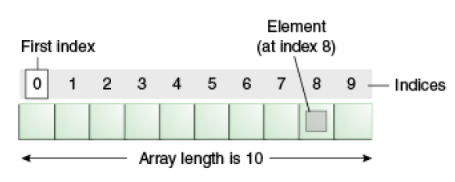
ARRAYS
Definition: An array is a collection of similar type of elements which has contiguous memory location
Array is an object which contains elements of a similar data type. Additionally, the elements of an array are stored in a contiguous memory location. It is a data structure where we store similar elements. We can store only a fixed set of elements in a Java array.
Array in Java is index-based, the first element of the array is stored at the 0th index, and 2nd element is stored on 1st index and so on.

Slide 2
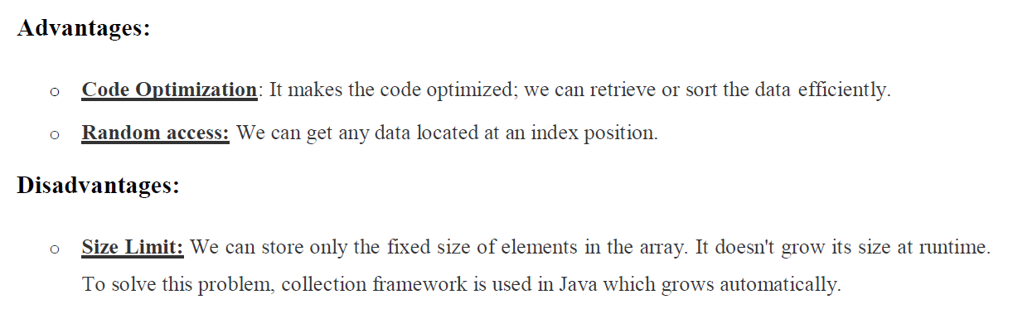
Types: There are different types of arrays in java
One Dimensional Array
Two Dimensional Array
Multi Dimensional Array

Slide 3
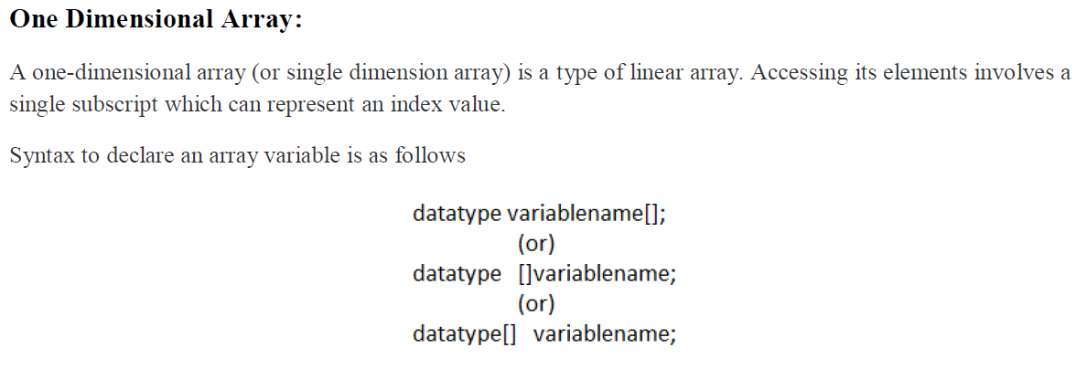
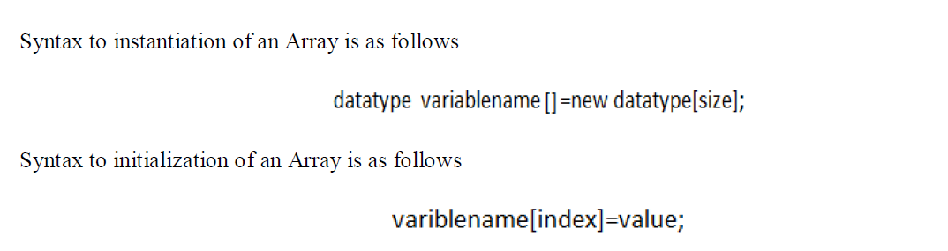

Slide 4
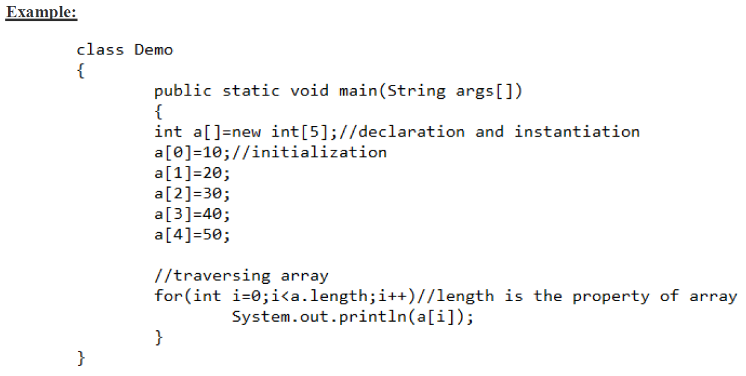

Slide 5
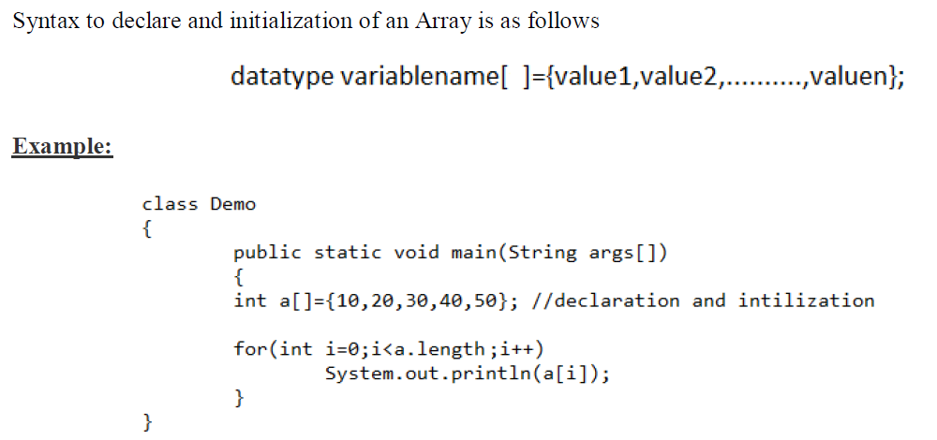

Slide 6
General Programs of 1D Array
1.Read and write 1D array
2.Rad and write in reverse order of 1D array
3.to print even numbers only
4.to print odd numbers only
5.to print sum of even no's only
6.to print sum of odd no's only
7.to print negative no's from array
8.Find the min and max elements from array

Slide 7
9.find out even no's in array and display in ascending order
10.sum of perfect square numbers from array

Slide 8
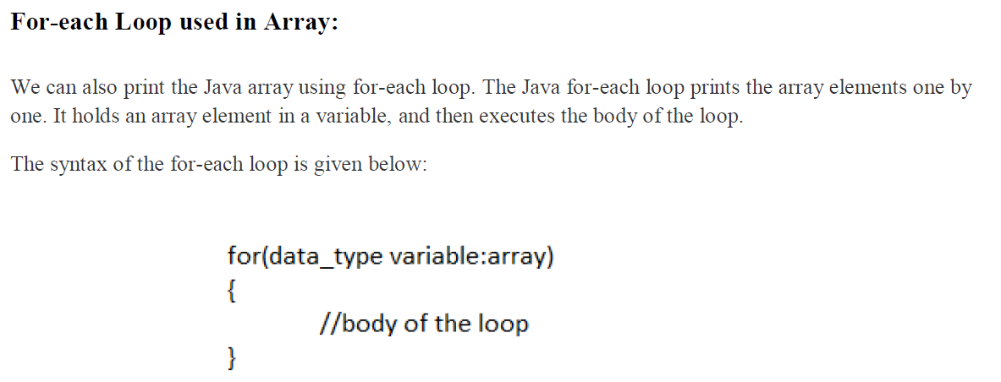

Slide 9
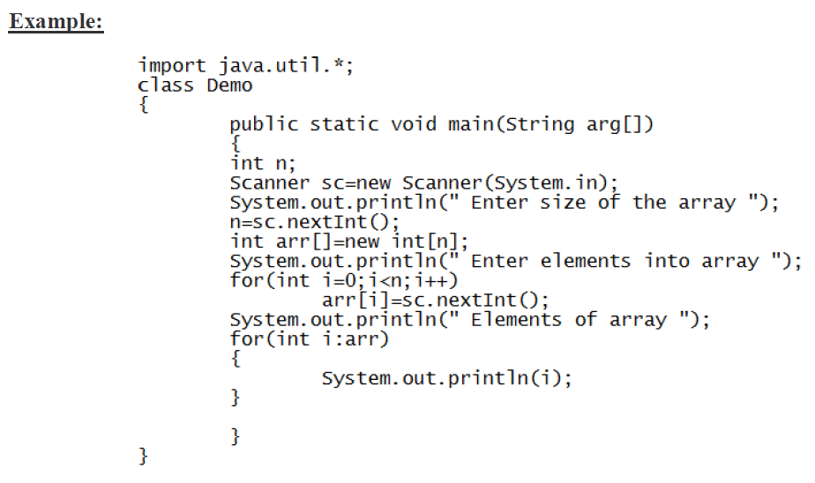

Slide 10
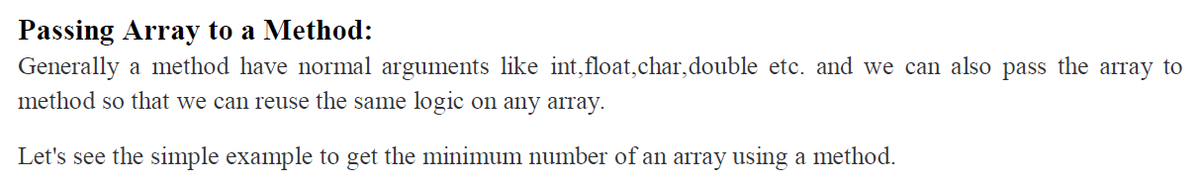
Example :
Write a java program passing array to a function and find out minimum value.

Slide 11
